Slide 1
Distributed Systems:
Principles and Paradigms
Chapter 01
Introduction

Slide 2
Prologue
Distributed Processing (분산 처리) vs. Distributed System (분산 시스템)
DS research in the 80’s vs. 90’s
Centralized vs. Distributed System
What are the examples of Distributed Systems?

Slide 3
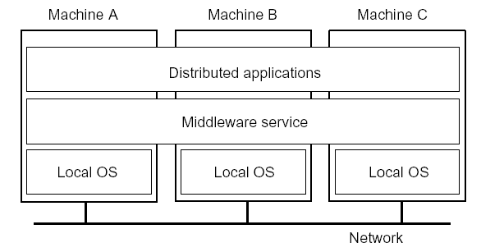
Distributed System: Definition
A distributed system is a collection of independent computers that appears to its users as a single coherent system
Two aspects:
(1) hardware - autonomous computers
(2) software – users think they are dealing with a single system
01 – 1 Introduction/1.1 Definition

Slide 4
Goals of Distributed Systems
Allow users to access and share resources
Transparency
  - To hide the fact that its processes and resources are physically distributed across multiple computers
Openness
  To offer services according to standard rules that describe the syntax and semantics of those services
  E.g., specify interfaces using an interface definition language (IDL)
Scalability
01 – 2 Introduction/1.2 Goals

Slide 5
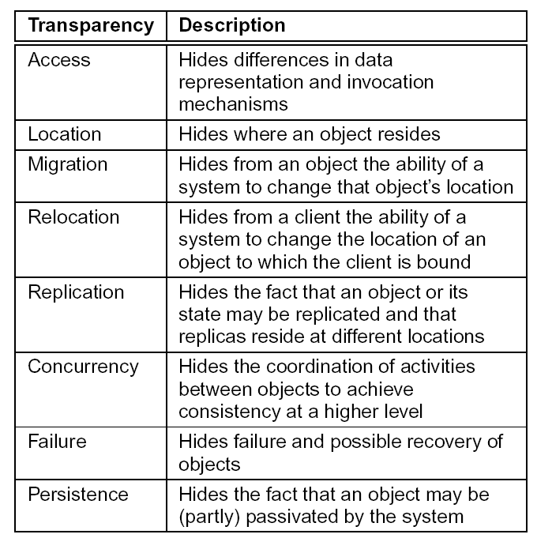
Transparency
01 – 3 Introduction/1.2 Goals

Slide 6
Degree of Transparency
Observation: Aiming at full transparency may be too much:
Users may be located in different continents; distribution is apparent and not something you want to hide
Completely hiding failures of networks and nodes is (theoretically and practically) impossible
– You cannot distinguish a slow computer from a failing one
– You can never be sure that a server actually performed an operation before a crash
Full transparency will cost performance, exposing distribution of the system
– Keeping Web caches exactly up-to-date with the master copy
– Immediately flushing write operations to disk for fault tolerance
01 – 4 Introduction/1.2 Goals

Slide 7
Openness of Distributed Systems
Open distributed system: Be able to interact with services from other open systems, irrespective of the underlying environment:
  Systems should conform to well-defined interfaces
  Systems should support portability of applications
  Systems should easily interoperate
Achieving openness: At least make the distributed system independent from heterogeneity of the underlying environment:
  Hardware
  Platforms
  Languages
01 – 5 Introduction/1.2 Goals

Slide 8
Policies versus Mechanisms
Implementing openness: Requires support for different policies specified by applications and users:
What level of consistency do we require for client cached data?
Which operations do we allow downloaded code to perform?
Which QoS requirements do we adjust in the face of varying bandwidth?
What level of secrecy do we require for communication?
Implementing openness: Ideally, a distributed system provides only mechanisms:
Allow (dynamic) setting of caching policies, preferably per cachable item
Support different levels of trust for mobile code
Provide adjustable QoS parameters per data stream
Offer different encryption algorithms
01 – 6 Introduction/1.2 Goals

Slide 9
Scalability in Distributed Systems
Observation: Many developers of modern distributed systems easily use the adjective “scalable” without making clear why their system actually scales.
Scalability: At least three components:
  Number of users and/or processes (size scalability)
  Maximum distance between nodes (geographical scalability)
  Number of administrative domains (administrative scalability)
Most systems account only, to a certain extent, for size scalability. The (non)solution: powerful servers.
Today, the challenge lies in geographical and administrative scalability.
01 – 7 Introduction/1.2 Goals

Slide 10
Techniques for Scaling
Distribution: Partition data and computations across multiple machines:
  Move computations to clients (Java applets)
  Decentralized naming services (DNS)
  Decentralized information systems (WWW)
Replication: Make copies of data available at different machines:
  Replicated file servers (mainly for fault tolerance)
  Replicated databases
  Mirrored Web sites
  Large-scale distributed shared memory systems
Caching: Allow client processes to access local copies:
  Web caches (browser/Web proxy)
  File caching (at server and client)
01 – 8 Introduction/1.2 Goals

Slide 11
Scaling – The Problem
Observation: Applying scaling techniques is easy, except for one thing:
Having multiple copies (cached or replicated), leads to inconsistencies: modifying one copy makes that copy different from the rest.
Always keeping copies consistent and in a general way requires global synchronization on each modification.
Global synchronization makes large-scale solutions practically impossible.
Observation: If we can tolerate inconsistencies, we may reduce the need for global synchronization.
Observation: Tolerating inconsistencies is application dependent.
01 – 9 Introduction/1.2 Goals

Slide 12
Distributed Systems: Hardware Concepts
Multiprocessors
Multicomputers
Networks of Computers
01 – 10 Introduction/1.3 Hardware Concepts

Slide 13
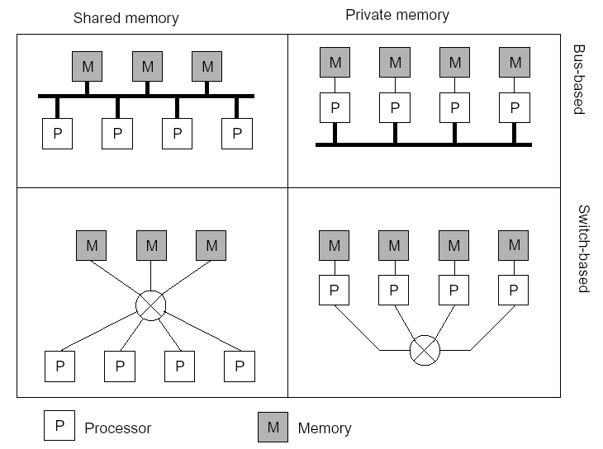
Multiprocessors and Multicomputers
Distinguishing features:
Private versus shared memory
Bus versus switched interconnection
01 – 11 Introduction/1.3 Hardware Concepts

Slide 14
Networks of Computers
High degree of node heterogeneity:
  High-performance parallel systems (multiprocessors as well as multicomputers)
  High-end PCs and workstations (servers)
  Simple network computers (offer users only network access)
  Mobile computers (palmtops, laptops)
High degree of network heterogeneity:
  Local-area gigabit networks
  Wireless connections
  Long-haul, high-latency POTS connections
  Wide-area switched megabit connections
Observation: Ideally, a distributed system hides these differences
01 – 12 Introduction/1.3 Hardware Concepts

Slide 15
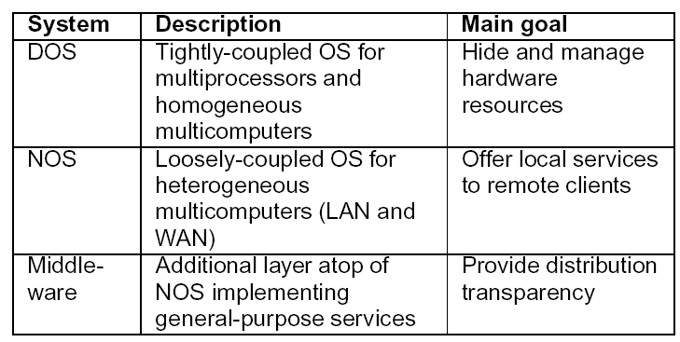
Distributed Systems:Software Concepts
Distributed operating system
Network operating system
Middleware
01 – 13 Introduction/1.4 Software Concepts

Slide 16
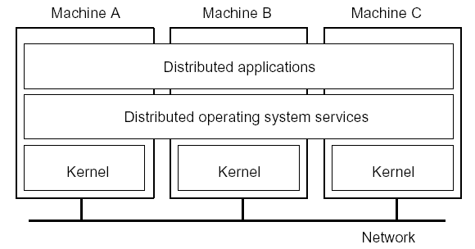
Distributed Operating System
Some characteristics:
OS on each computer knows about the other computers
OS on different computers generally the same
Services are generally (transparently) distributed across computers
01 – 14 Introduction/1.4 Software Concepts

Slide 17
Multicomputer Operating System
Harder than traditional (multiprocessor) OS: Because memory is not shared, emphasis shifts to processor communication by message passing:
Often no simple global communication:
  Only bus-based multicomputers provide hardware broadcasting
  Efficient broadcasting may require network interface programming techniques
No simple system-wide synchronization mechanisms
Virtual (distributed) shared memory requires OS to maintain global memory map in software
Inherent distributed resource management: no central point where allocation decisions can be made
Practice: Only very few truly multicomputer operating systems exist (example: Amoeba)
01 – 15 Introduction/1.4 Software Concepts

Slide 18
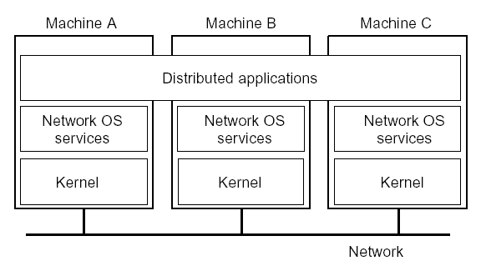
Network Operating System
Some characteristics:
Each computer has its own operating system with networking facilities
Computers work independently (i.e., they may even have different operating systems)
Services are tied to individual nodes (ftp, telnet,WWW)
Highly file oriented (basically, processors share only files)
01 – 16 Introduction/1.4 Software Concepts

Slide 19
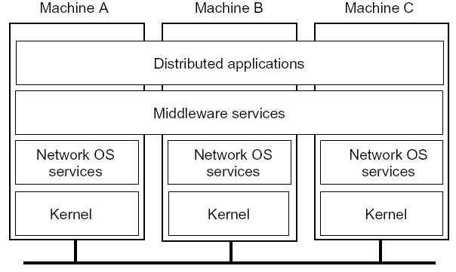
Middleware
Some characteristics:
OS on each computer need not know about the other computers
OS on different computers need not generally be the same
Services are generally (transparently) distributed across computers
01 – 17 Introduction/1.4 Software Concepts

Slide 20
Need for Middleware
Motivation: Too many networked applications were difficult to integrate:
Departments are running different NOSs
Integration and interoperability only at level of primitive NOS Services
Need for federated information systems:
– Combining different databases, but providing a single view to applications
– Setting up enterprise-wide Internet services, making use of existing information systems
– Allow transactions across different databases
– Allow extensibility for future services (e.g., mobility, teleworking, collaborative applications)
Constraint: use the existing operating systems, and treat them as the underlying environment
01 – 18 Introduction/1.4 Software Concepts

Slide 21
Middleware Services (1/2)
Communication services: Abandon primitive socket-based message passing in favor of:
  Procedure calls across networks
  Remote-object method invocation
  Message-queuing systems
  Advanced communication streams
  Event notification service
Information system services: Services that help manage data in a distributed system:
  Large-scale, system-wide naming services
  Advanced directory services (search engines)
  Location services for tracking mobile objects
  Persistent storage facilities
  Data caching and replication
01 – 19 Introduction/1.4 Software Concepts

Slide 22
Middleware Services (2/2)
Control services: Services giving applications control over when, where, and how they access data:
  Distributed transaction processing
  Code migration
Security services: Services for secure processing and communication:
  Authentication and authorization services
  Simple encryption services
  Auditing service
01 – 20 Introduction/1.4 Software Concepts

Slide 23
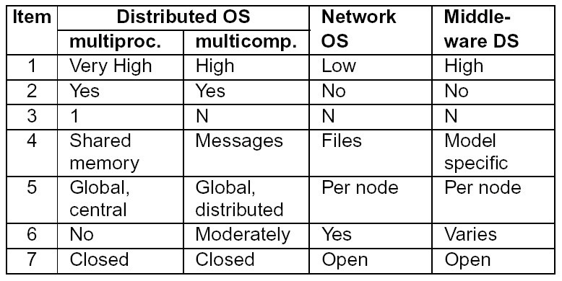
Comparison of DOS, NOS, and Middleware
1: Degree of transparency
2: Same operating system on each node?
3: Number of copies of the operating system
4: Basis for communication
5: How are resources managed?
6: Is the system easy to scale?
7: How open is the system?
01 – 21 Introduction/1.4 Software Concepts

Slide 24
Client–Server Model
Basic model
Application layering
Client–Server architectures
01 – 22 Introduction/1.5 Client–Server Model

Slide 25
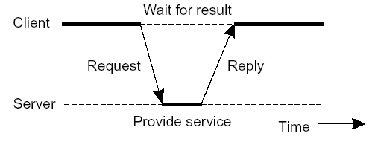
Basic Client–Server Model (1/2)
Characteristics:
There are processes offering services (servers)
There are processes that use services (clients)
Clients and servers can be distributed across different machines
Clients follow request/reply model with respect to using services
01 – 23 Introduction/1.5 Client–Server Model

Slide 26
Basic Client–Server Model (2/2)
Servers: Generally provide services related to a shared resource:
Servers for file systems, databases, implementation repositories, etc.
Servers for shared, linked documents (Web, VoD)
Servers for shared applications
Servers for shared distributed objects
Clients: Allow remote service access:
Programming interface transforming client’s local service calls to request/reply messages
Devices with (relatively simple) digital components (barcode readers, teller machines, hand-held phones)
Computers providing independent user interfaces for specific services
Computers providing an integrated user interface for related services (compound documents)
01 – 24 Introduction/1.5 Client–Server Model

Slide 27
Application Layering (1/2)
Traditional three-layered view:
User-interface layer contains units for an application’s user interface
Processing layer contains the functions of an application, i.e. without specific data
Data layer contains the data that a client wants to manipulate through the application components
Observation: This layering is found in many distributed information systems, using traditional database technology and accompanying applications.
01 – 25 Introduction/1.5 Client–Server Model

Slide 28
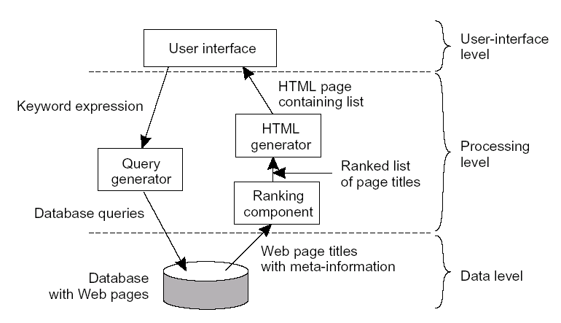
Application Layering (2/2)
01 – 26 Introduction/1.5 Client–Server Model

Slide 29
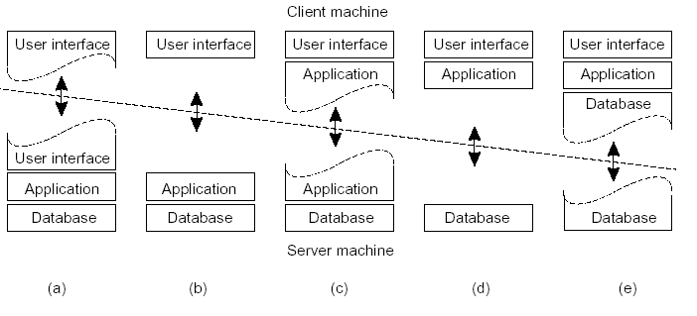
Client-Server Architectures
Single-tiered: dumb terminal/mainframe configuration
Two-tiered: client/single server configuration
Three-tiered: each layer on separate machine
Traditional two-tiered configurations:
01 – 27 Introduction/1.5 Client–Server Model

Slide 30
Alternative C/S Architectures
Observation: Multi-tiered architectures seem to constitute buzzwords that fail to capture many modern client–server systems.
Cooperating servers: Service is physically distributed across a collection of servers:
  Traditional multi-tiered architectures
  Replicated file systems
  Network news services
  Large-scale naming systems (DNS, X.500)
  Workflow systems
  Financial brokerage systems
Cooperating clients: Distributed application exists by virtue of client collaboration:
Teleconferencing where each client owns a (multimedia) workstation
Publish/subscribe architectures in which role of client and server is blurred
Peer-to-Peer (P2P) applications
01 – 28 Introduction/1.5 Client–Server Model

Slide 31
Reading
Read Chapter 1 of Distributed Systems: Principles and Paradigms book
01 – 28 Introduction/1.5 Client–Server Model

